Slide 1
Association of Natural Resource Extension Professionals
Advancing Natural Resource Education and Collaboration

Slide 2
Our Mission
"Providing a national peer-to-peer forum for members to network, innovate, and collaborate while advancing the professional status and recognition of our unique role as educators in the field of natural resources."

Slide 3
Who can join?
Active & retired natural resource Extension System or Sea Grant employees (at any level)
Active members: may vote, hold elected or appointed positions
Natural resource education/outreach professional from other organizations or other countries
Affiliate members: may not vote or hold elected office, but can do everything else
Students enrolled full-time at university level
Notes:
Active members are eligible to vote, and affiliate members are

Slide 4
Many disciplines!
Forestry
Wildlife
Fisheries
Wood
Range
Outdoor
Rec
Energy
Water
Env. Ed.
Youth
ANREP

Slide 5
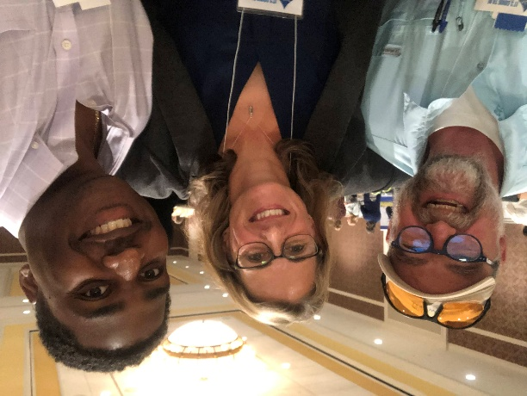
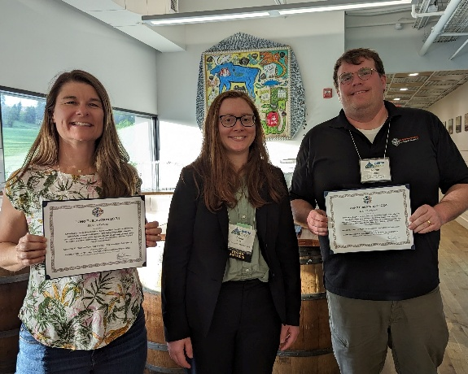
Member benefits
Professional development – biennial conference, webinars, meet-ups, travel scholarships
Leadership opportunities – national board, committees
Recognition – national annual awards program
Networking – national focus initiatives, state chapters
Communication – monthly member newsletter, jobs board

Slide 6
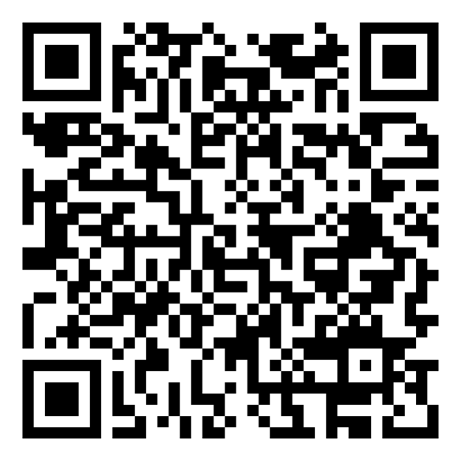
Join now! Anrep.org
Or Sign up now to Receive Information on Joining
$75/year – active & affiliate
$30/year- students
Questions? anrep@anrep.org
https://member.anrep.org/members/form.php?orgcode=ANRE&fid=8089319

Slide 7
ANREP colors, logo & find more anrep promotional toolkit: https://anrep.org/anrep_promotional_toolkit.php

