Slide 1
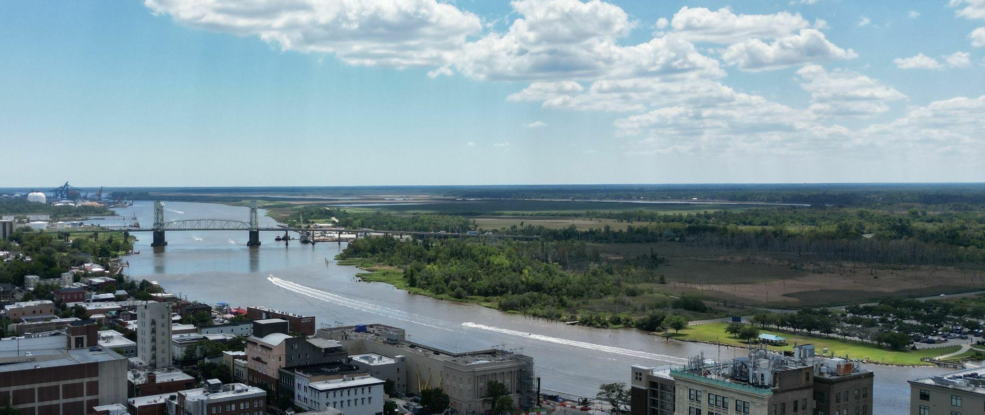
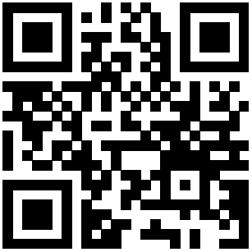
Association of Natural Resource Extension Professionals 15th Biennial Conference
May 12-15, 2026, Wilmington, NC
Confluence of Knowledge: Charting the Future of Natural Resource Extension
Call for abstracts opening July 2025
Conference website: go.ncsu.edu/anrep2026
Hosted by:

Slide 2
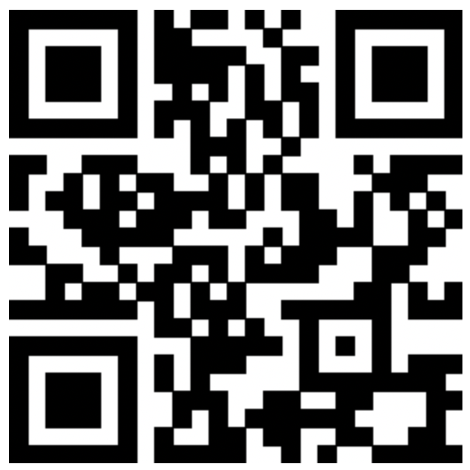
Conference Committee
Call for Volunteers!
Robert Bardon, NC State
Janice Sitzes, NC State
Renee Strnad, NC State
David Herpy, NC State
Biswanath Dari, NC A&T
Sanjok Poudel, NC A&T
Erika Young, NC Sea Grant
Bindu Bhakta, Michigan State
Calvin Norman, Penn State
Maddy Goebel, Univ. of Idaho
Leslie Boby, ANREP Board
Dean Solomon, ANREP Executive
Sponsorship Committee
Abstract Reviewers
Scan the QR code to indicate your interest!

